Slide 1
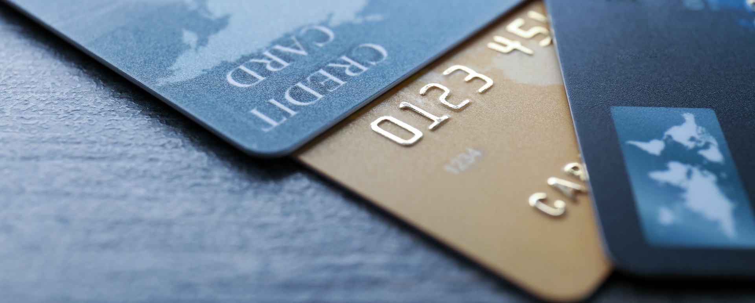
DATA ANALYSIS ON CREDIT CARD DEFAULTERS
PRESENTED BY GROUP-6
AVIRAL AGRAWAL
BHAVANA JOSHI
URJASVIT SINHA

Slide 2







CONTENTS
ABSTRACT
DATASET DESCRIPTION
STATISTICAL ANALYSIS
VISUALIZATION
HYPOTHESIS TESTING
PREDICTION USING DECISION TREE
REFEReNCES

Slide 3
ABSTRACT
In this digital world, the usage of credit cards has been increasing exponentially day by day. General-purpose credit cards such as Visa, MasterCard, and Discover can be found in 70.2 percent of all-American households, according to the U.S. Census Bureau. According to a study, the number of card payments per day more than doubled between 2006 and 2016, with approximately 17.7 million card payments per day conducted in 2006, and 39.2 million payments per day in 2016. When you accept a credit card, you agree to certain terms. For example, you agree to make your minimum payment by the due date listed on your credit card statement. If you miss the minimum credit card payment six months in a row, your credit card will be in default. Your credit card issuer will likely close your account and report the default to the credit bureaus. This dataset features such as credit card defaulters in Taiwan in the months from April to September 2005. It contains personal information about the customer like gender, education, marital status, age, etc. It also contains payment-related information like amount given as credit, history of past payment, amount of bill statements and amount of previous payments. We intend to use different statistical methods to extract meaningful information and patterns of the defaulters. We shall also try to forecast critical statistics and probabilities useful for the bank to prevent such situations. The results of our analysis can help the banks to identify their customers as credible or not credible clients.

Slide 4
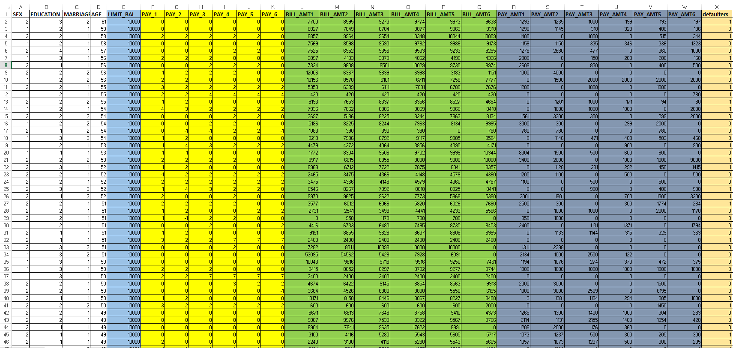
SCREENSHOT OF DATASET:

Slide 5
DATA SET DESCRIPTION
Sr. No. | Attribute | Value
1 | Sex | Gender (1 = male; 2 = female)
2 | Education | Education level (1 = graduate school; 2 = university; 3 = high school; 4 = others)
3 | Marriage | Marital status (1 = married; 2 = single; 3 = others)
4 | Age | Age (in years)
5 | Limit_Bal | Limit of the credit card
6 | Pay_1 to Pay_6 | History of past payment
7 | Bill_amt_1 to Bill_amt_6 | Amount of bill statement
8 | Pay_amt_1 to Pay_amt_6 | Amount of previous payment
9 | Defaulters | Default payment (Yes = 1, No = 0)

Slide 6
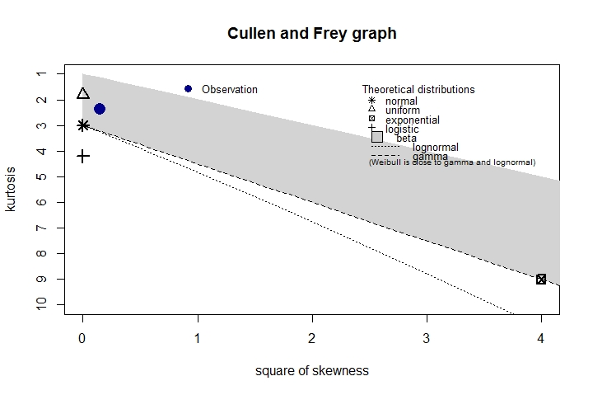
Cullen and Frey Graph for LIMIT BALANCE

Slide 7
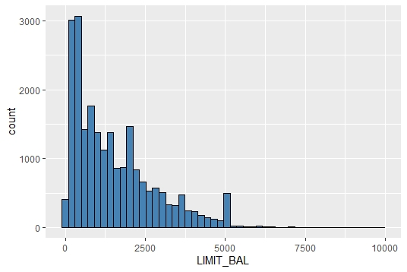
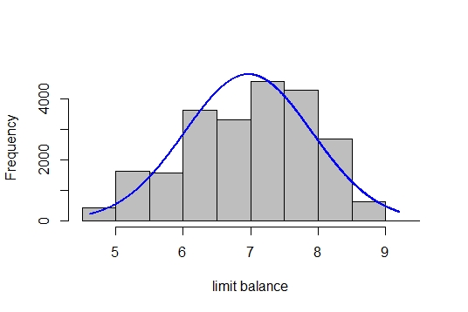
Normalization of Limit Balance Attribute

Slide 8
CATEGORIZATION OF DATA
CATEGORY | GENDER | EDUCATION | MARITIAL STATUS
CATEGORY 1 | Male | Graduate/University | Single/other
CATEGORY 2 | Female | Graduate/University | Single/other
CATEGORY 3 | Male | High School/other | Single/other
CATEGORY 4 | Female | High School/other | Single/other
CATEGORY 5 | Male | Graduate/University | Married
CATEGORY 6 | Female | Graduate/University | Married
CATEGORY 7 | Male | High School/other | Married
CATEGORY 8 | Female | High School/other | Married

Slide 9
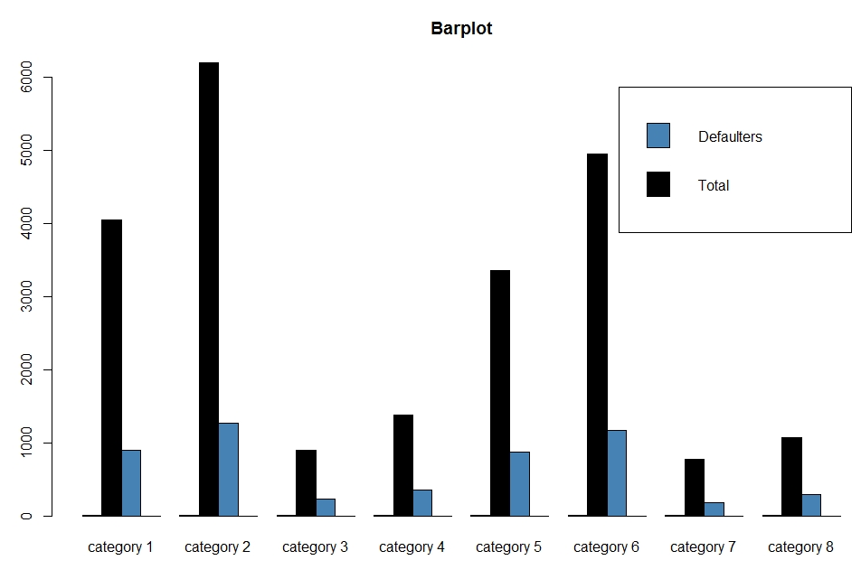
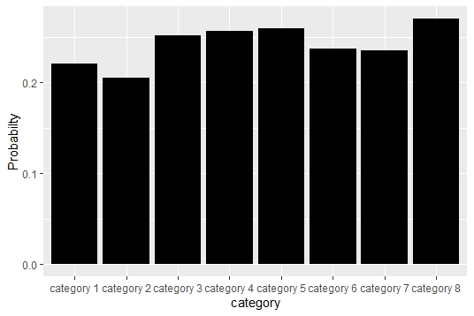
BARPLOT
Number of individuals and defaulters in each category
Probability of defaulters in each category

Slide 10
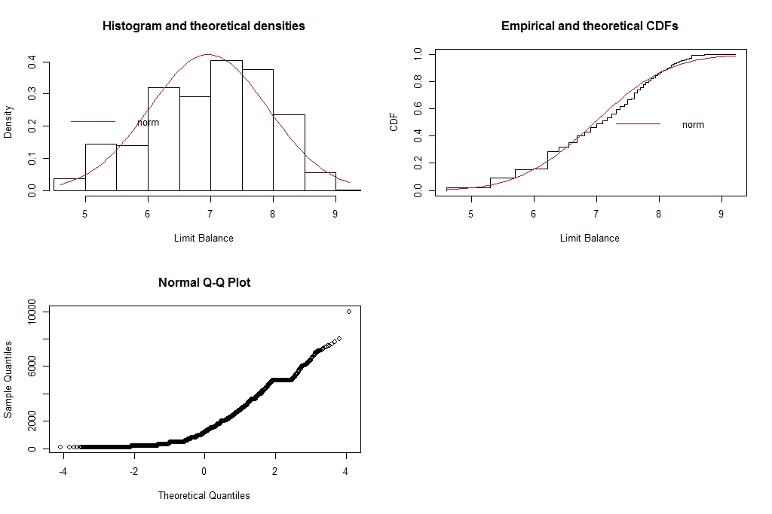
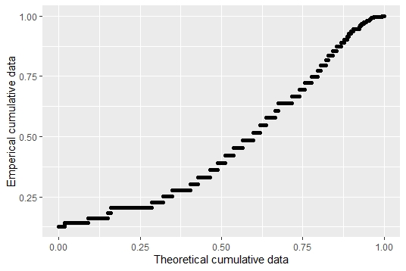
GOODNESS OF FIT TEST
Normal P-P Plot

Slide 11
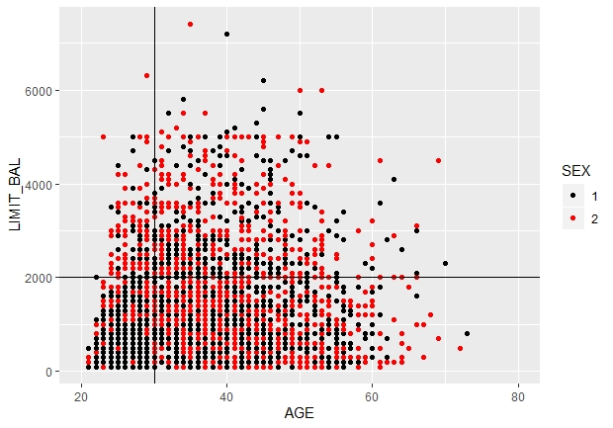
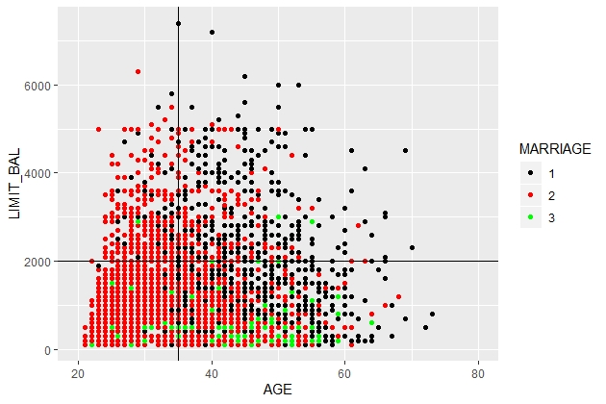
Scatter Plot
Relation between age and limit balance based on gender
Relation between age and limit balance based on marital status

Slide 12
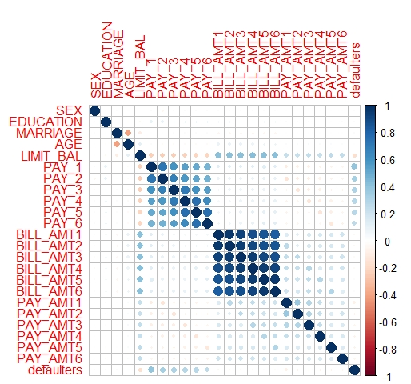
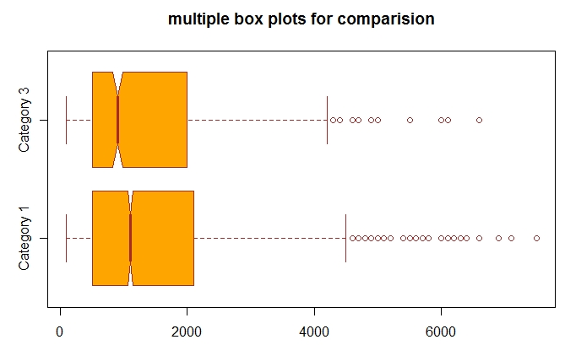
Correlation Plot
Boxplot

Slide 13
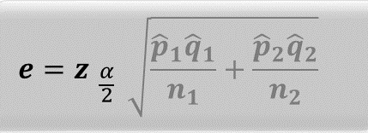
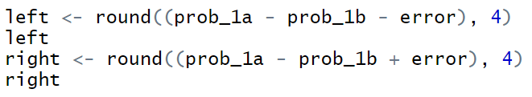
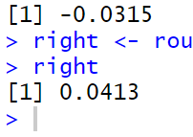
Confidence interval of proportions
Comparing the sample data of 1000 and 1300 individuals (from category 1 i.e, married males with university or higher education level) with 95% confidence level for each of the sample data

Slide 14
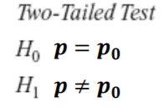
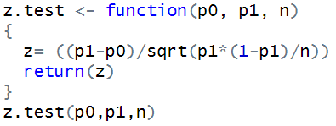
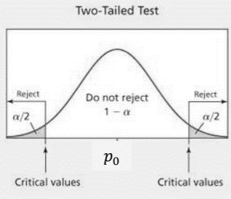


Test of hypothesis of proportions
H1: Sample Proportion of unmarried men with higher education is equal to known proportion
H0: Sample Proportion of unmarried men with higher education is not equal to known proportion
n = 5000
Confidence interval = 95%
1
1
$Z_{0.025 }$<z.test <${ Z}_{0.975 }$
-1.959964 <-0.5192789 <1.959964
We fail to reject null hypothesis

Slide 15
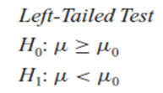
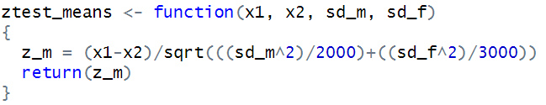
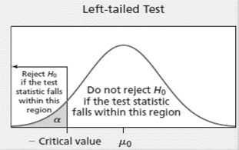

Test of hypothesis of means
H0: Male customers are given greater limit balance as compared to female customers
H1: Male customers are given less limit balance as compared to female customers
n1 = 5000
n2 = 5000
Confidence interval = 95%
$Z_{0.025 }$< z.test
-1.959964 < -0.483366
We fail to reject null hypothesis

Slide 16
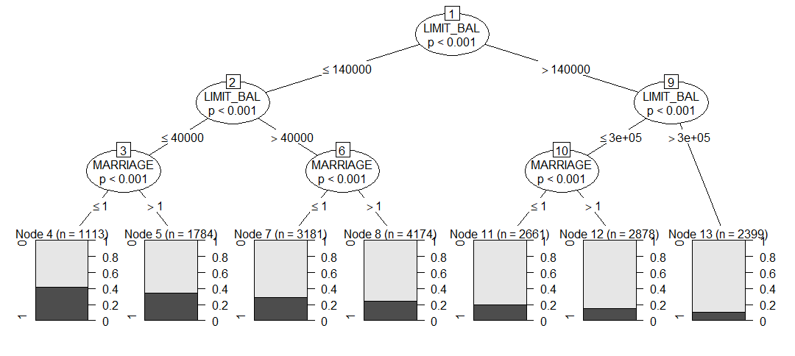
Decision Tree

Slide 17
REFRENCES
https://archive.ics.uci.edu
www.stackoverflow.com
www.dummies.com
www.statmethods.net
www.datacamp.com
www.youtube.com

Slide 18
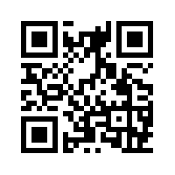
THANK YOU
Kindly rate us using the QR code given HERE

